Slide 1

CT Fire Chiefs Association Meeting
22 September 2020

Slide 2
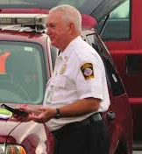
Chief John Duffy Bradley International Fire Department

Slide 3
Bradley International Airport Vintage B 17 Aircraft Incident 2 October 2019
OVERVIEW/HISTORY
COLLINS FOUNDATION
EMERGENCY RESPONSE
MUTUAL AID
AIRCRAFT REMOVAL
RECOVERY
EMOTIONAL SUPPORT

Slide 4
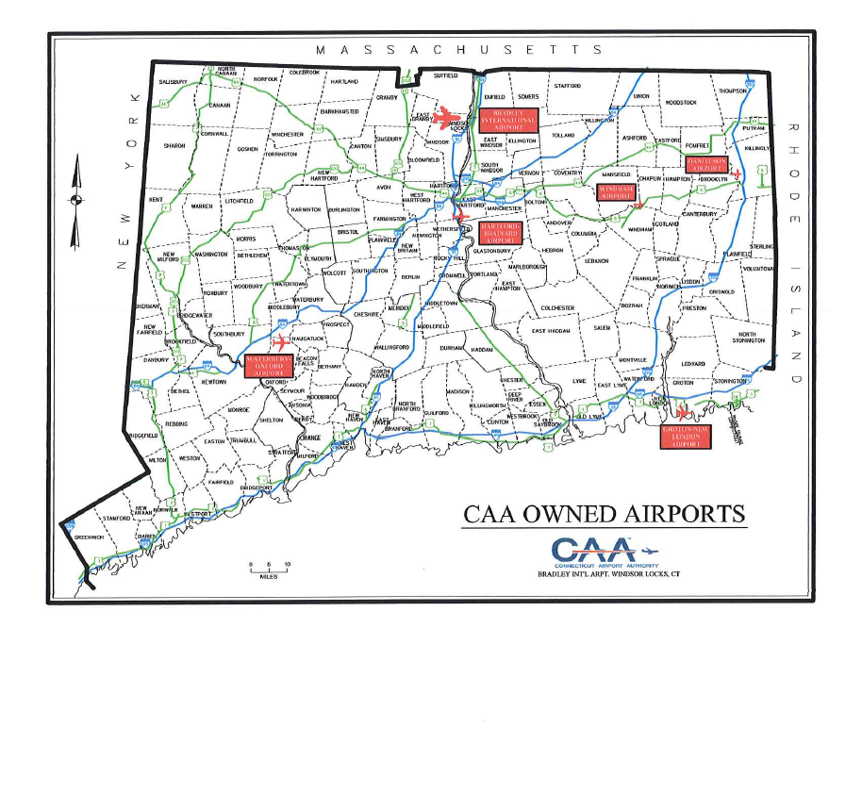

Slide 6
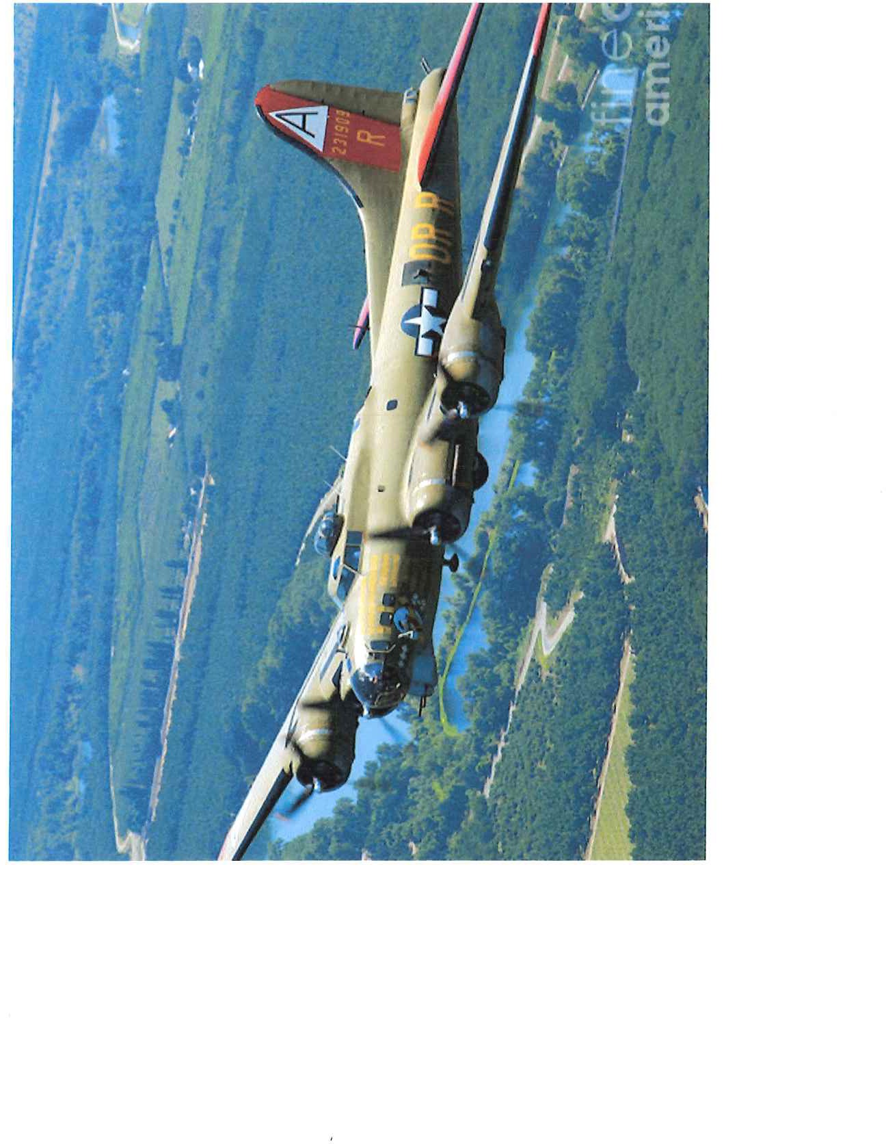
Collins Foundation B-17 Flying Fortress

Slide 8
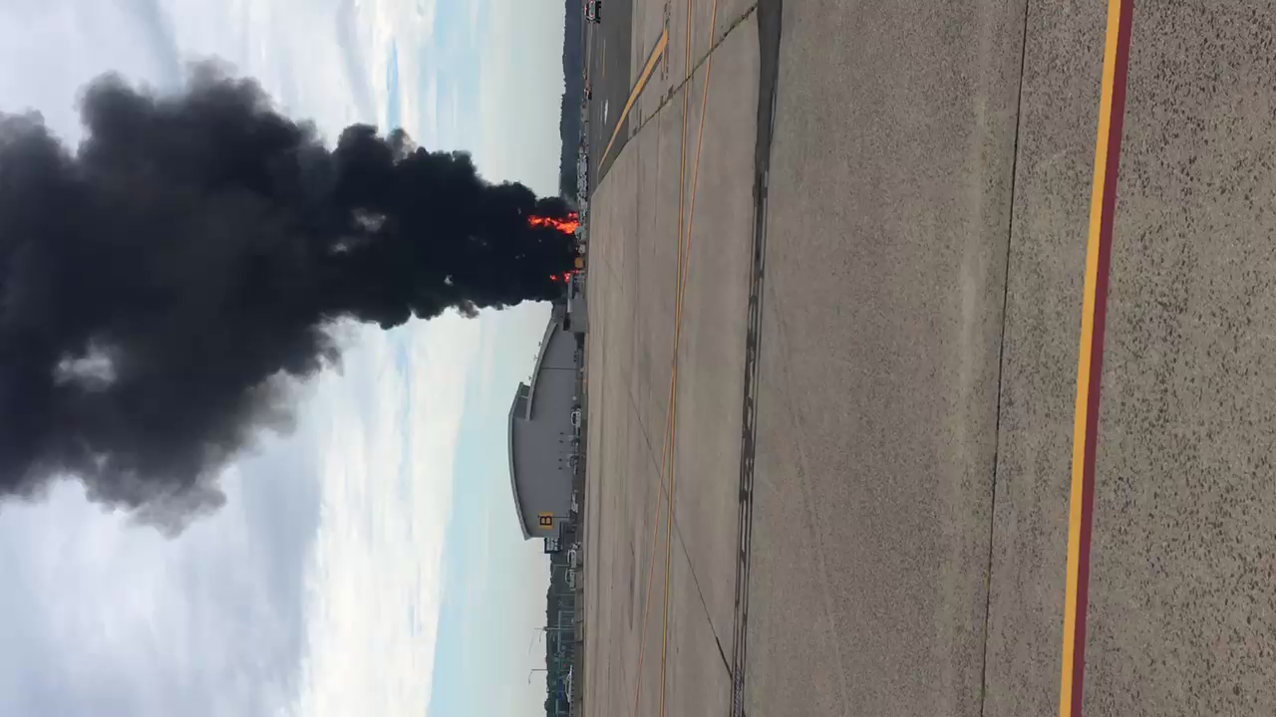

Slide 12
Bradley Fire Emergency Plan 2nd Alarm
Bloomfield FD - Pumper
Blue Hills FD - Aerial
Collins Aerospace FD - EMS
East Granby FD – Pumper
Suffield FD - Pumper
Windsor FD - Aerial
Windsor Locks FD – Pumper & Rescue

Slide 13
Bradley Fire Emergency Plan 3rd Alarm (modified)
East Granby Tanker/Tender
Suffield Tanker/ Tender
After 3rd Alarm RED PLAN is utilized

Slide 14
Additional Resources
Task Force 53 Assigned to Windsor Locks East Side of Airport
Task Force 51 Assigned to East Granby West Side of Airport
Enfield - Quint & Rescue
Hazardville - Engine
Thompsonville - Engine
North Thompsonville - Aerial
Shaker Pines - Engine
Berlin – Engine
Cromwell – Rescue
Newington – Engine
Rocky Hill – Engine & Aerial
Wethersfield – Aerial

Slide 15
Additional Resources Initial Operation Period
Hartford County Coordinators
Statewide Fire Plan
ESF 2 Communications
ESF 4 Fire
ESF 5 Emergency Management
EMS/CMED
CAA
CT ANG
  CMED MCI protocols
  State/Local Police
  FBI
  State Fire Marshal
  USAR
  NTSB
  14th CST CTNG
  CT DEEP
  FAA
  Airport Ops

Slide 23
Q & A

Slide 24

Thank You
CT STATEWIDE FIRE-RESCUE PLAN TASK FORCE 52
Bloomfield FD
Blue Hills FD
Bradley International Airport FD
CT Air National Guard FD
Collins Aerospace FD
East Granby FD
Suffield FD
Windsor FD
Windsor Locks FD

